Slide 1
CS 295A/395D: Artificial Intelligence
Elementary Game Theory
Prof. Emma Tosch
30 March 2022

Slide 2
Agenda
Review decision theory
Elementary game theory
Optimum vs. optimal solutions
Strategies
Vocabulary

Slide 3
Logistics
BB theory assignment out today
Exam through game theory
Temporal reasoning pushed to next unit
Exam next Friday (April 8)
Next unit: temporal reasoning and program synthesis
Removed machine learning

Slide 4
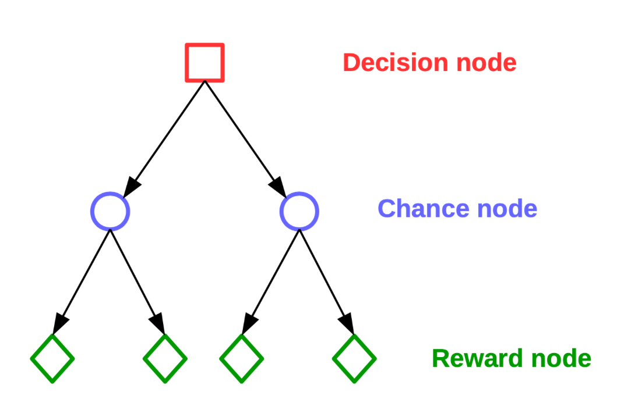
Recap: Decision Theory
We can express taking actions in a world with uncertainty via decision trees
Decisions trees are temporally-ordered nodes where each level corresponds to alternating:
Decision nodes – state of the system; outgoing edges represent different actions
Chance nodes – probability distributions over outcomes; outgoing edges represent reachable states with some probability
Reward nodes – utility obtained from following the path
Note: “decision tree” also refers to a classification algorithm in machine learning and is completely different from the type of decision tree we will talk about here.

Slide 5
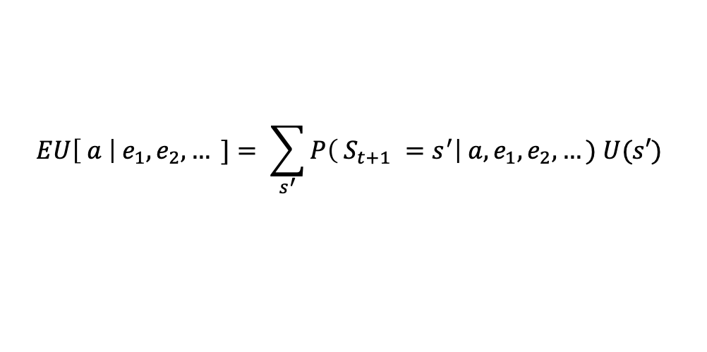

Recap: Maximize expected utility
$$EU\left[ a \right|{ e}_{1},e_{2},… ]= \sum_{s^{′}}{P\left( S_{t+1} =s^{′}\right| a, e_{1},e_{2},…) U(s′) }$$
Best action is the action a that maximizes $EU\left[ a \right|{ e}_{1},e_{2},… ]$
Sum of the utility of actions taken.
Note: “decision tree” also refers to a classification algorithm in machine learning and is completely different from the type of decision tree we will talk about here.

Slide 6
Recap: Comparing actions
$$EU\left[ a \right|{ e}_{1},e_{2},… ]= \sum_{s^{′}}{P\left( S_{t+1} =s^{′}\right| a, e_{1},e_{2},…) U(s′) }$$
Probability mass function – over all sources of uncertainty associated with this action.
Utility function
Basic actions: reward
Actions with subsequent actions with uncertain outcomes: EU of those actions
Note: “decision tree” also refers to a classification algorithm in machine learning and is completely different from the type of decision tree we will talk about here.

Slide 7
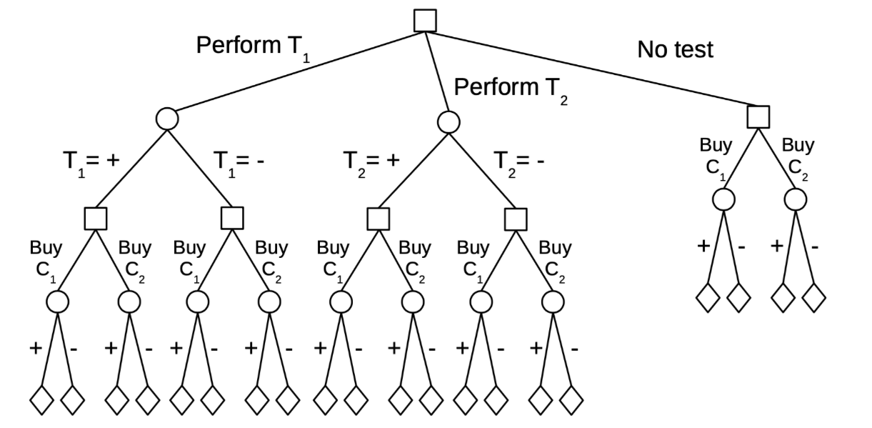

Slide 8
Pick the car with the higher EU
$$EU\left[C_{1}\right]=P\left(C_{1}= +\right)\left(cost\left(C_{1}\right)\right)+P(C_{1}=−)(cost\left(C_{1}\right)+repair\left(C_{1}\right))$$
$$EU\left[C_{2}\right]=P\left(C_{2}= +\right)\left(cost\left(C_{2}\right)\right)+P(C_{2}=−)(cost\left(C_{2}\right)+repair\left(C_{2}\right))$$

Slide 10
$$EU\left[C_{1} | T_{1}= +\right]= P\left(C_{1}= + | { T}_{1}= + \right)\left(cost\left(C_{1}\right)+cost(T_{1})\right)$$
$+ P\left(C_{1}= − \right| T_{1}= +)(cost\left(C_{1}\right)+repair\left(C_{1}\right)+cost(T_{1}))$

Slide 11
Didn’t have P(C|T) → needed to compute via Bayes Rule
$$EU\left[C_{1} | T_{1}= +\right]= P\left(C_{1}= + | { T}_{1}= + \right)\left(cost\left(C_{1}\right)+cost(T_{1})\right)$$
$+ P\left(C_{1}= − \right| T_{1}= +)(cost\left(C_{1}\right)+repair\left(C_{1}\right)+cost(T_{1}))$

Slide 12
P(C|T) required P(T) → compute via law of total probability
$$EU\left[C_{1} | T_{1}= +\right]= P\left(C_{1}= + | { T}_{1}= + \right)\left(cost\left(C_{1}\right)+cost(T_{1})\right)$$
$+ P\left(C_{1}= − \right| T_{1}= +)(cost\left(C_{1}\right)+repair\left(C_{1}\right)+cost(T_{1}))$

Slide 13
T₁ gives us no information about C₂ → independent
$$EU\left[C_{1} | T_{1}= +\right]= P\left(C_{1}= + | { T}_{1}= + \right)\left(cost\left(C_{1}\right)+cost(T_{1})\right)$$
$+ P\left(C_{1}= − \right| T_{1}= +)(cost\left(C_{1}\right)+repair\left(C_{1}\right)+cost(T_{1}))$
$$EU\left[C_{2} | T_{1}=+\right]$$

Slide 14
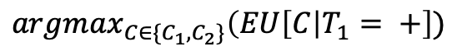
Deterministically choose the car with higher expected utility given T₁ = +
$$EU\left[C_{1} | T_{1}= +\right]= P\left(C_{1}= + | { T}_{1}= + \right)\left(cost\left(C_{1}\right)+cost(T_{1})\right)$$
$+ P\left(C_{1}= − \right| T_{1}= +)(cost\left(C_{1}\right)+repair\left(C_{1}\right)+cost(T_{1}))$
$$EU\left[C_{2} | T_{1}=+\right]=P\left(C_{2}= +\right)\left(cost\left(C_{2}\right)+cost(T_{1})\right)+P\left(C_{2}=−\right)\left(cost\left(C_{2}\right)+repair\left(C_{2}\right)+cost\left(T_{1}\right)\right)$$
$$=cost\left(T_{1}\right)∗ EU\left[C_{2}\right]$$
$$argmax_{C∈\{C_{1}, C_{2}\}}\left(EU\left[C\right|T_{1}= +\right])$$

Slide 15
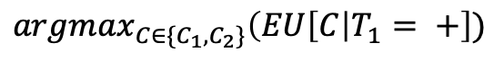
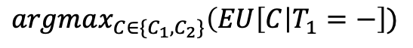
$$argmax_{C∈\{C_{1}, C_{2}\}}\left(EU\left[C\right|T_{1}= +\right])$$
$$argmax_{C∈\{C_{1}, C_{2}\}}\left(EU\left[C\right|T_{1}=−\right])$$

Slide 16
$$argmax_{C∈\{C_{1}, C_{2}\}}\left(EU\left[C\right|T_{1}= +\right])$$
$$argmax_{C∈\{C_{1}, C_{2}\}}\left(EU\left[C\right|T_{1}=−\right])$$
$$EU\left[T_{1}\right]=P\left(T_{1}= + \right)U\left(T_{1}= +\right)+P\left(T_{1}=−\right)U(T_{1}=−)$$
If we deterministically choose C₁ when T₁ = +, …
????

Slide 17
$$argmax_{C∈\{C_{1}, C_{2}\}}\left(EU\left[C\right|T_{1}= +\right])$$
$$argmax_{C∈\{C_{1}, C_{2}\}}\left(EU\left[C\right|T_{1}=−\right])$$
$$EU\left[T_{1}\right]=P\left(T_{1}= + \right)EU\left(C_{1}\right|T_{1}= +)+P\left(T_{1}=−\right)U(T_{1}=−)$$
If we deterministically choose C₁ when T₁ = +, …

Slide 18
$$argmax_{C∈\{C_{1}, C_{2}\}}\left(EU\left[C\right|T_{1}= +\right])$$
$$argmax_{C∈\{C_{1}, C_{2}\}}\left(EU\left[C\right|T_{1}=−\right])$$
$$EU\left[T_{1}\right]=P\left(T_{1}= + \right)EU\left(C_{1}\right|T_{1}= +)+P\left(T_{1}=−\right)U(T_{1}=−)$$
If we deterministically choose C₂ when T₁ = -, …

Slide 19
$$argmax_{C∈\{C_{1}, C_{2}\}}\left(EU\left[C\right|T_{1}= +\right])$$
$$argmax_{C∈\{C_{1}, C_{2}\}}\left(EU\left[C\right|T_{1}=−\right])$$
$$EU\left[T_{1}\right]=P\left(T_{1}= + \right)EU\left(C_{1}\right|T_{1}= +)+P\left(T_{1}=−\right)U(T_{1}=−)$$
If we deterministically choose C₂ when T₁ = -, …

Slide 20
Perform the same analysis on T2, then we can decide which test!
$$argmax_{C∈\{C_{1}, C_{2}\}}\left(EU\left[C\right|T_{1}= +\right])$$
$$argmax_{C∈\{C_{1}, C_{2}\}}\left(EU\left[C\right|T_{1}=−\right])$$
$$EU\left[T_{1}\right]=P\left(T_{1}= + \right)EU\left(C_{1}\right|T_{1}= +)+P\left(T_{1}=−\right)EU\left(C_{2}\right|T_{1}=−)$$
If we deterministically choose C₂ when T₁ = -, …

Slide 21
Context: single decision
Two agents (“players”)
Take the perspective of a single player
Make one decision, under uncertainty
We will revisit game theory and search (e.g., minimax) after introducing reasoning over time

Slide 22
When uncertainty comes from another agent’s actions
Car example: taking an action in one branch closes off possibilities in another
Randomness comes from
Epistemic uncertainty about effects of past actions (e.g., accuracy of test results)
Epistemic uncertainty about future state (e.g., quality of car)
Consider the case when randomness comes from another agent’s actions…

Slide 23
Example: Prisoner’s Dilemma
You (agent P) and an accomplice (agent Q) have been arrested for a crime…
You (P) talk
You (P) stay silent
But Q also knows all this and must make the same choices…
Q talks
Q stays silent

Slide 24
Example: Prisoner’s Dilemma
You (agent P) and an accomplice (agent Q) have been arrested for a crime…
You (P) talk
You (P) stay silent
Q talk
Q stay silent
Q talks
Q stays silent
You talk
You stay silent
????
Both parties know this

Slide 25
Example: Prisoner’s Dilemma
Utility function: Collective cost?
P and Q have been arrested for a crime and separated for interrogation. You have the choice of whether or not to confess and each action is associated with a cost. You don’t know how your accomplice will act. What do you do?
Q silent
P silent
P talks
(0, 0) | (-2, -5)
(-5, -2) | (-10, -10)
Q talks
Both parties know this matrix

Slide 26
Example: Prisoner’s Dilemma
Utility function: Collective cost?
P and Q have been arrested for a crime and separated for interrogation. You have the choice of whether or not to confess and each action is associated with a cost. You don’t know how your accomplice will act. What do you do?
Both choose silent if both are using the same utility function
Q silent
P silent
P talks
0 | -7
-7 | -20
Q talks
Both parties know this matrix

Slide 27
Example: Prisoner’s Dilemma
Utility function: Collective cost?
P and Q have been arrested for a crime and separated for interrogation. You have the choice of whether or not to confess and each action is associated with a cost. You don’t know how your accomplice will act. What do you do?
What if one uses a different utility function?
Q silent
P silent
P talks
0 | -7
-7 | -20
Q talks
Both parties know this matrix

Slide 28
Example: Prisoner’s Dilemma
Utility function:
Individual Cost?
You and an accomplice have been arrested for a crime and separated for interrogation. You have the choice of whether or not to confess and each action is associated with a cost. You don’t know how your accomplice will act. What do you do?
Q silent
P silent
P talks
(0, 0) | (-2, -5)
(-5, -2) | (-10, -10)
Q talks
Both parties know this matrix

Slide 29
Example: Prisoner’s Dilemma
Utility function:
Individual cost?
You and an accomplice have been arrested for a crime and separated for interrogation. You have the choice of whether or not to confess and each action is associated with a cost. You don’t know how your accomplice will act. What do you do?
Q silent
P silent
P talks
0 | -2
-5 | -10
Q talks
Both parties know this matrix

Slide 30
Example: Prisoner’s Dilemma
Utility function:
Individual cost?
You and an accomplice have been arrested for a crime and separated for interrogation. You have the choice of whether or not to confess and each action is associated with a cost. You don’t know how your accomplice will act. What do you do?
Q silent
P silent
P talks
0 | -5
-2 | -10
Q talks
Both parties know this matrix

Slide 31
Example: Prisoner’s Dilemma
Utility function:
Individual Cost?
You and an accomplice have been arrested for a crime and separated for interrogation. You have the choice of whether or not to confess and each action is associated with a cost. You don’t know how your accomplice will act. What do you do?
Q silent
P silent
P talks
(0, 0) | (-2, -5)
(-5, -2) | (-10, -10)
Q talks
Both parties know this matrix

Slide 32
Example: Prisoner’s Dilemma
Local reasoning, rather than global
You and an accomplice have been arrested for a crime and separated for interrogation. You have the choice of whether or not to confess and each action is associated with a cost. You don’t know how your accomplice will act. What do you do?
Q silent
P silent
P talks
Decision/action
(0, 0) | (-2, -5)
(-5, -2) | (-10, -10)
Q talks
Uncertainty

Slide 33
Example: Prisoner’s Dilemma
Local reasoning, rather than global
You and an accomplice have been arrested for a crime and separated for interrogation. You have the choice of whether or not to confess and each action is associated with a cost. You don’t know how your accomplice will act. What do you do?
You (P) talk
You (P) stay silent
Q talks
Q stays silent
Decision/action
Q silent
P silent
P talks
(0, 0) | (-2, -5)
(-5, -2) | (-10, -10)
-10
-2
-5
0
Q talks
Uncertainty

Slide 34
Example: Prisoner’s Dilemma
Local reasoning, rather than global
You and an accomplice have been arrested for a crime and separated for interrogation. You have the choice of whether or not to confess and each action is associated with a cost. You don’t know how your accomplice will act. What do you do?
Q silent
P silent
P talks
Decision/action
(0, 0) | (-2, -5)
(-5, -2) | (-10, -10)
Q talks
Uncertainty

Slide 35
Example: Prisoner’s Dilemma
You and an accomplice have been arrested for a crime and separated for interrogation. You have the choice of whether or not to confess and each action is associated with a cost. You don’t know how your accomplice will act. What do you do?
Q silent
P silent
P talks
Uncertainty
(0, 0) | (-2, -5)
(-5, -2) | (-10, -10)
Q talks
Decision/action

Slide 36
Example: Prisoner’s Dilemma
You and an accomplice have been arrested for a crime and separated for interrogation. You have the choice of whether or not to confess and each action is associated with a cost. You don’t know how your accomplice will act. What do you do?
Q talks
Q stays silent
P talks
P stays silent
Uncertainty
Q silent
P silent
P talks
(0, 0) | (-2, -5)
(-5, -2) | (-10, -10)
-10
-5
-2
0
Q talks
Decision/action

Slide 37
Example: Prisoner’s Dilemma
You and an accomplice have been arrested for a crime and separated for interrogation. You have the choice of whether or not to confess and each action is associated with a cost. You don’t know how your accomplice will act. What do you do?
Q silent
P silent
P talks
(0, 0) | (-2, -5)
(-5, -2) | (-10, -10)
Q talks

Slide 38
Example: Prisoner’s Dilemma
You and an accomplice have been arrested for a crime and separated for interrogation. You have the choice of whether or not to confess and each action is associated with a cost. You don’t know how your accomplice will act. What do you do?
Q silent
P silent
P talks
(0, 0) | (-2, -5)
(-5, -2) | (-10, -10)
Q talks

Slide 39
Example: Prisoner’s Dilemma
You and an accomplice have been arrested for a crime and separated for interrogation. You have the choice of whether or not to confess and each action is associated with a cost. You don’t know how your accomplice will act. What do you do?
Q silent
P silent
P talks
(0, 0) | (-2, -5)
(-5, -2) | (-10, -10)
Q talks

Slide 40
Example: Prisoner’s Dilemma
You and an accomplice have been arrested for a crime and separated for interrogation. You have the choice of whether or not to confess and each action is associated with a cost. You don’t know how your accomplice will act. What do you do?
Q silent
P silent
P talks
(0, 0) | (-2, -5)
(-5, -2) | (-10, -10)
Q talks

Slide 41
Example: Prisoner’s Dilemma
You and an accomplice have been arrested for a crime and separated for interrogation. You have the choice of whether or not to confess and each action is associated with a cost. You don’t know how your accomplice will act. What do you do?
Q silent
P silent
P talks
(0, 0) | (-2, -5)
(-5, -2) | (-10, -10)
Q talks

Slide 42
Example: Prisoner’s Dilemma
You and an accomplice have been arrested for a crime and separated for interrogation. You have the choice of whether or not to confess and each action is associated with a cost. You don’t know how your accomplice will act. What do you do?
Q silent
P silent
P talks
(0, 0) | (-2, -5)
(-5, -2) | (-10, -10)
Q talks

Slide 43
Example: Prisoner’s Dilemma
You and an accomplice have been arrested for a crime and separated for interrogation. You have the choice of whether or not to confess and each action is associated with a cost. You don’t know how your accomplice will act. What do you do?
Q silent
P silent
P talks
(0, 0) | (-2, -5)
(-5, -2) | (-10, -10)
Q talks

Slide 44
Example: Prisoner’s Dilemma
You and an accomplice have been arrested for a crime and separated for interrogation. You have the choice of whether or not to confess and each action is associated with a cost. You don’t know how your accomplice will act. What do you do?
Q silent
P silent
P talks
(0, 0) | (-2, -5)
(-5, -2) | (-10, -10)
Q talks

Slide 45
Example: Prisoner’s Dilemma
You and an accomplice have been arrested for a crime and separated for interrogation. You have the choice of whether or not to confess and each action is associated with a cost. You don’t know how your accomplice will act. What do you do?
Q silent
P silent
P talks
(0, 0) | (-2, -5)
(-5, -2) | (-10, -10)
Q talks
Same as globally optimal case for both utility functions

Slide 46
Example: Prisoner’s Dilemma
Consider a different payoff matrix
You and an accomplice have been arrested for a crime and separated for interrogation. You have the choice of whether or not to confess and each action is associated with a cost. You don’t know how your accomplice will act. What do you do?
Q silent
P silent
P talks
(-2, -2) | (0, -15)
(-15, 0) | (-10, -10)
Q talks
Still globally optimal for collective utility?

Slide 47
Example: Prisoner’s Dilemma
You and an accomplice have been arrested for a crime and separated for interrogation. You have the choice of whether or not to confess and each action is associated with a cost. You don’t know how your accomplice will act. What do you do?
Q silent
P silent
P talks
-4 | -15
-15 | -20
Q talks
Still globally optimal for collective utility?

Slide 48
Example: Prisoner’s Dilemma
Assume Q uses collective utility, but P uses individual utility…
You and an accomplice have been arrested for a crime and separated for interrogation. You have the choice of whether or not to confess and each action is associated with a cost. You don’t know how your accomplice will act. What do you do?
Q silent
P silent
P talks
-2 | 0
-15 | -10
Q talks
Still globally optimal for individual utility for P?

Slide 49
Example: Prisoner’s Dilemma
What if Q knows P’s utility function and decides to mimic?
You and an accomplice have been arrested for a crime and separated for interrogation. You have the choice of whether or not to confess and each action is associated with a cost. You don’t know how your accomplice will act. What do you do?
Q silent
P silent
P talks
-2 | -15
0 | -10
Q talks
Still globally optimal for individual utility?

Slide 50
Example: Prisoner’s Dilemma
What if Q knows P’s utility function and decides to mimic?
You and an accomplice have been arrested for a crime and separated for interrogation. You have the choice of whether or not to confess and each action is associated with a cost. You don’t know how your accomplice will act. What do you do?
Q silent
P silent
P talks
-2 | -15
0 | -10
Q talks
Still globally optimal for individual utility?

Slide 51
Example: Prisoner’s Dilemma
You and an accomplice have been arrested for a crime and separated for interrogation. You have the choice of whether or not to confess and each action is associated with a cost. You don’t know how your accomplice will act. What do you do?
Q silent
P silent
P talks
(-2, -2) | (0, -15)
(-15, 0) | (-10, -10)
Q talks

Slide 52
Example: Prisoner’s Dilemma
You and an accomplice have been arrested for a crime and separated for interrogation. You have the choice of whether or not to confess and each action is associated with a cost. You don’t know how your accomplice will act. What do you do?
Q silent
P silent
P talks
-4 | -15
-15 | -20
Q talks
Worst possible global outcome!

Slide 53
Example: Prisoner’s Dilemma
Local reasoning, rather than global
You and an accomplice have been arrested for a crime and separated for interrogation. You have the choice of whether or not to confess and each action is associated with a cost. You don’t know how your accomplice will act. What do you do?
Q silent
P silent
P talks
(-2, -2) | (0, -15)
(-15, 0) | (-10, -10)
Q talks

Slide 54
Example: Prisoner’s Dilemma
You and an accomplice have been arrested for a crime and separated for interrogation. You have the choice of whether or not to confess and each action is associated with a cost. You don’t know how your accomplice will act. What do you do?
Q silent
P silent
P talks
(-2, -2) | (0, -15)
(-15, 0) | (-10, -10)
Q talks

Slide 55
Example: Prisoner’s Dilemma
You and an accomplice have been arrested for a crime and separated for interrogation. You have the choice of whether or not to confess and each action is associated with a cost. You don’t know how your accomplice will act. What do you do?
Q silent
P silent
P talks
(-2, -2) | (0, -15)
(-15, 0) | (-10, -10)
Q talks

Slide 56
Example: Prisoner’s Dilemma
You and an accomplice have been arrested for a crime and separated for interrogation. You have the choice of whether or not to confess and each action is associated with a cost. You don’t know how your accomplice will act. What do you do?
Q silent
P silent
P talks
(-2, -2) | (0, -15)
(-15, 0) | (-10, -10)
Q talks

Slide 57
Example: Prisoner’s Dilemma
You and an accomplice have been arrested for a crime and separated for interrogation. You have the choice of whether or not to confess and each action is associated with a cost. You don’t know how your accomplice will act. What do you do?
Q silent
P silent
P talks
(-2, -2) | (0, -15)
(-15, 0) | (-10, -10)
Q talks

Slide 58
Example: Prisoner’s Dilemma
You and an accomplice have been arrested for a crime and separated for interrogation. You have the choice of whether or not to confess and each action is associated with a cost. You don’t know how your accomplice will act. What do you do?
Q silent
P silent
P talks
(-2, -2) | (0, -15)
(-15, 0) | (-10, -10)
Q talks

Slide 59
Example: Prisoner’s Dilemma
You and an accomplice have been arrested for a crime and separated for interrogation. You have the choice of whether or not to confess and each action is associated with a cost. You don’t know how your accomplice will act. What do you do?
Q silent
P silent
P talks
(-2, -2) | (0, -15)
(-15, 0) | (-10, -10)
Q talks

Slide 60
Example: Prisoner’s Dilemma
You and an accomplice have been arrested for a crime and separated for interrogation. You have the choice of whether or not to confess and each action is associated with a cost. You don’t know how your accomplice will act. What do you do?
Q silent
P silent
P talks
(-2, -2) | (0, -15)
(-15, 0) | (-10, -10)
Q talks

Slide 61
Example: Prisoner’s Dilemma
You and an accomplice have been arrested for a crime and separated for interrogation. You have the choice of whether or not to confess and each action is associated with a cost. You don’t know how your accomplice will act. What do you do?
Q silent
P silent
P talks
(-2, -2) | (0, -15)
(-15, 0) | (-10, -10)
Q talks

Slide 62
Example: Prisoner’s Dilemma
You and an accomplice have been arrested for a crime and separated for interrogation. You have the choice of whether or not to confess and each action is associated with a cost. You don’t know how your accomplice will act. What do you do?
Q silent
P silent
P talks
(-2, -2) | (0, -15)
(-15, 0) | (-10, -10)
Q talks
Same result!

Slide 63
Example: Prisoner’s Dilemma
You and an accomplice have been arrested for a crime and separated for interrogation. You have the choice of whether or not to confess and each action is associated with a cost. You don’t know how your accomplice will act. What do you do?
Q silent
P silent
P talks
(-2, -2) | (0, -5)
(-5, 0) | (-10, -10)
Q talks

Slide 64
Example: Prisoner’s Dilemma
You and an accomplice have been arrested for a crime and separated for interrogation. You have the choice of whether or not to confess and each action is associated with a cost. You don’t know how your accomplice will act. What do you do?
Q silent
P silent
P talks
(-2, -2) | (0, -5)
(-5, 0) | (-10, -10)
Q talks

Slide 65
Example: Prisoner’s Dilemma
You and an accomplice have been arrested for a crime and separated for interrogation. You have the choice of whether or not to confess and each action is associated with a cost. You don’t know how your accomplice will act. What do you do?
Q silent
P silent
P talks
(-2, -2) | (0, -5)
(-5, 0) | (-10, -10)
Q talks

